Slide 1
Inferring Missing Data in Multidimensional Arrays using Tensor Completion Algorithms
Joshua Coon/5448
Dylan Anderson/6755
Joshua Zollweg/6755
Sandia National Laboratories is a multimission laboratory managed and operated by National Technology and Engineering Solutions of Sandia, LLC, a wholly owned subsidiary of Honeywell International, Inc., for the U.S. Department of Energy’s National Nuclear Security Administration under contract DE-NA0003525. SAND2017-8452 C

Slide 2
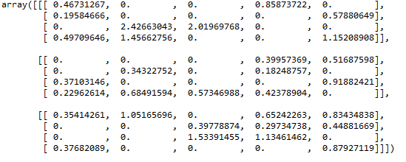
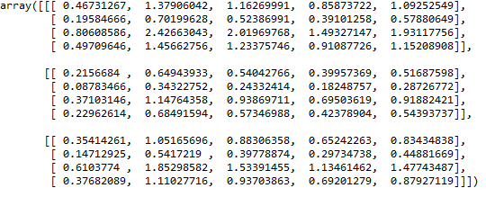
Problem Background
Goal: fill in missing values in a given data tensor (multidimensional data array).
Sparse Tensor (3x4x5)
Full Tensor (3x4x5)
Zeros are placeholders for missing (unmeasured) values

Slide 3
Description of Computation Tools Used
All code written in Python 3.6 framework with basic libraries
Numpy
Scipy
Matplotlib
All results presented calculated on desktop computer in my office:
Intel Xeon Multicore @ 3.7GHz
128 GB RAM
Algorithms written by team and kept in Gitlab codebase
Implementation based off papers cited in slides

Slide 4
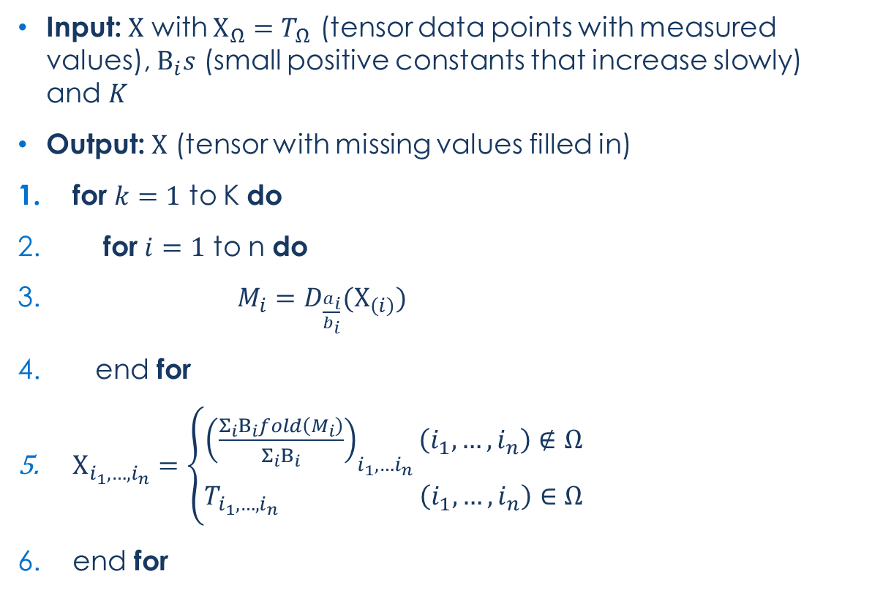
Simple Low Rank Tensor Completion (SiLRTC) Algorithm
Simple Low Rank Tensor Completion (SiLRTC) Algorithm
Input: $Χ$ with $Χ_{Ω}=T_{Ω}$ (tensor data points with measured values), $Β_{i}s$ (small positive constants that increase slowly) and $K$
Output: $Χ$ (tensor with missing values filled in)
for $k=1$ to K do
for $i=1$ to n do
$M_{i}=D_{\frac{a_{i}}{b_{i}}}(Χ_{\left(i\right)})$
end for
$Χ_{i_{1},…,i_{n}}=\left\{\begin{aligned}{\left(\frac{Σ_{i}Β_{i}fold\left(M_{i}\right)}{Σ_{i}Β_{i}}\right)}_{i_{1},…i_{n}}\left(i_{1},…, i_{n}\right)∉Ω \\ T_{i_{1},…,i_{n}} \left(i_{1},…,i_{n}\right)∈Ω\end{aligned}\right.$
end for
Notes:
Notes:
3. $D_{\frac{a_{i}}{b_{i}}}$ is the “shrinkage” operator – shrink data by:
Taking SVD: $Χ=UΣV^{T}$
Truncating singular values below given threshold $(\frac{a_{i}}{b_{i}})$
Reconstructing matrix $Χ_{(\frac{a_{i}}{b_{i}})}=UΣ_{(\frac{a_{i}}{b_{i}})}V^{T}$
3. Shrinkage operator applied to each unfolded mode of the tensor
5. Top half of equation is fills in missing entries by taking weighted average of shrinkage data from each unfolded tensor mode
5. Bottom half of equation fills in non-missing entries with “known” values
Liu, Ji, et al. "Tensor completion for estimating missing values in visual data." IEEE Transactions on Pattern Analysis and Machine Intelligence 35.1 (2013): 208-220.

Slide 5
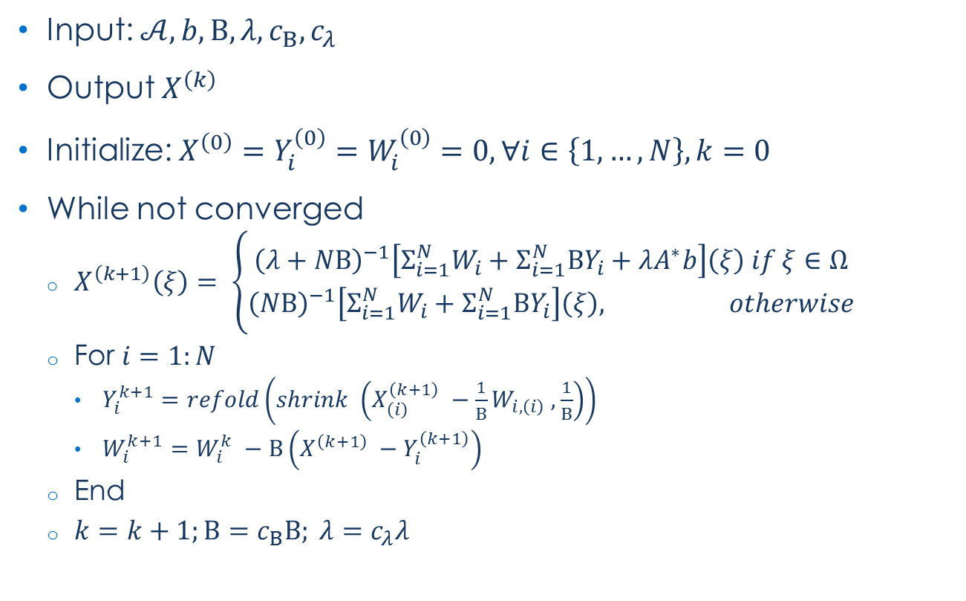
Alternating Decent Method (ADM)
Alternating Decent Method (ADM)
Input: $𝒜, b, Β, λ, c_{Β}, c_{λ}$
Output $X^{\left(k\right)}$
Initialize: $X^{\left(0\right)}=Y_{i}^{\left(0\right)}=W_{i}^{\left(0\right)}=0, ∀i∈\left\{1, …, N\right\}, k=0$
While not converged
$X^{\left(k+1\right)}\left(ξ\right)= \left\{\begin{aligned}{\left(λ+NΒ\right)}^{−1}\left[Σ_{i=1}^{N}W_{i}+Σ_{i=1}^{N}ΒY_{i}+λA^{∗}b\right]\left(ξ\right) if ξ∈Ω \\ {\left(NΒ\right)}^{−1}\left[Σ_{i=1}^{N}W_{i}+Σ_{i=1}^{N}ΒY_{i}\right]\left(ξ\right), otherwise\end{aligned}\right.$
For $i=1:N$
$Y_{i}^{k+1}=refold\left(shrink \left(X_{\left(i\right)}^{\left(k+1\right)} −\frac{1}{Β}W_{i,\left(i\right)} ,\frac{1}{Β}\right)\right)$
$W_{i}^{k+1}=W_{i}^{k} −Β\left(X^{\left(k+1\right)} −Y_{i}^{\left(k+1\right)}\right)$
End
$k=k+1;Β=c_{Β}Β; λ=c_{λ}λ$
Notes:
Notes:
$A^{∗}b$ is a map to known data values (e.g. $ξ∈Ω$)
$N$is dimension of the tensor
“shrink” operator is same as SiLRTC
Fold refolds matricized tensor into a n-way tensor
Algorithm is “robust” - it allows for errors in input data and missing values
Gandy, Silvia, Benjamin Recht, and Isao Yamada. "Tensor completion and low-n-rank tensor recovery via convex optimization." Inverse Problems 27.2 (2011): 025010.

Slide 6
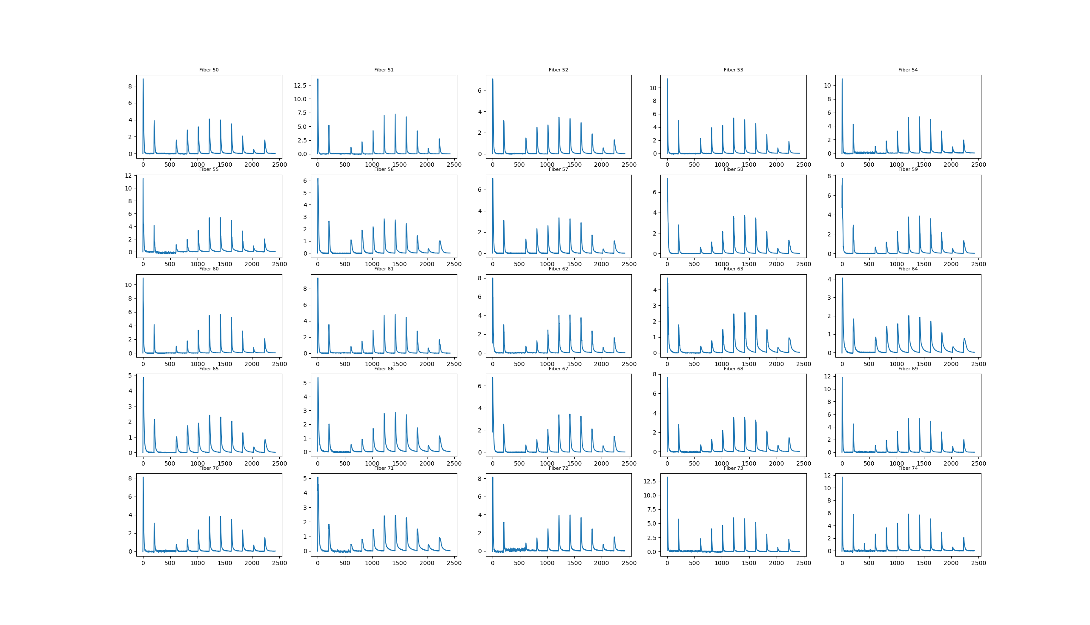
Description of the data used
Spectrotemporal data of high energy (HE) events
Shape: 402 x 12 x 202
Dimensions: Samples x Band x Time
Sample fibers along Sample axis are shown on the left

Slide 7
Description of Data Removal
Salt and Pepper Noise
Removed entries at random locations throughout the data set by setting to zero
Operationally similar to instruments that have corrupted transmission of certain data points due to atmospheric noise or noise effects
Band Noise
Removed bands of data
Algorithm:
Input: number_of_bands_to_remove for each sample
for sample in Samples (3D tensor -> 2D matrix)
count = 0
do
Set random row of matrix equal to zero (if not already identically zero)
count += 1
while count < number_of_bands_to_remove
Constraint: At least one band had to be kept in lower and upper half of band index: mimics some operational conditions

Slide 8
Results

Slide 9
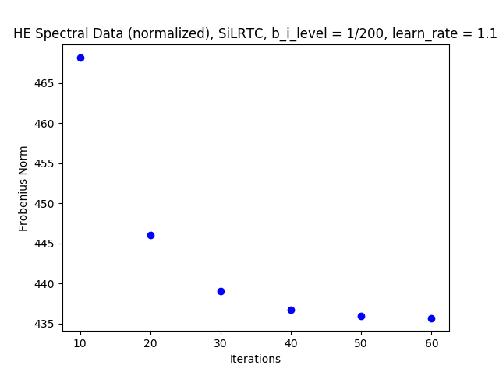
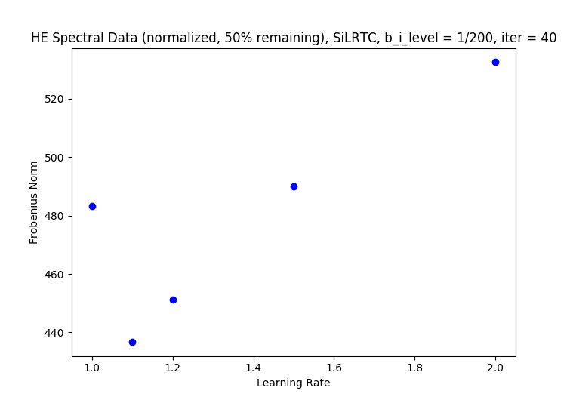
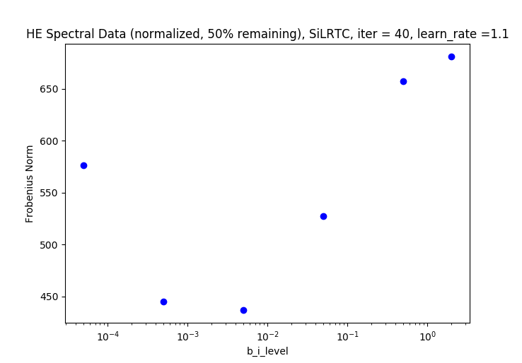
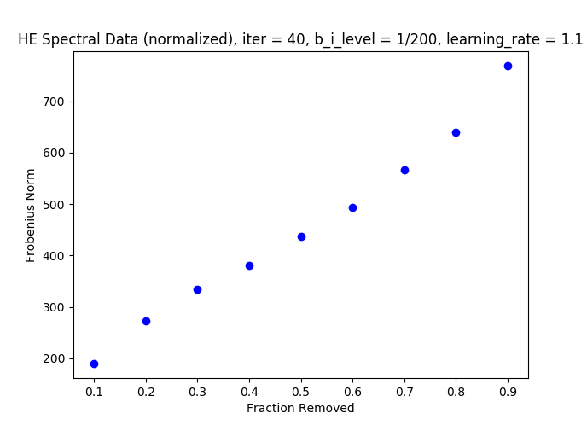
Hyperparameter Optimization: SiLRTC
Plots show effects of various parameter settings for SiLRTC algorithm
High Energy (HE) normalized (energy normalization) data set
Plots are Frobenius norm vs:
Iterations (top left)
Learning Rate (bottom left)
Eigenvalue cutoff level (top right)
Fraction removed (bottom right)

Slide 10
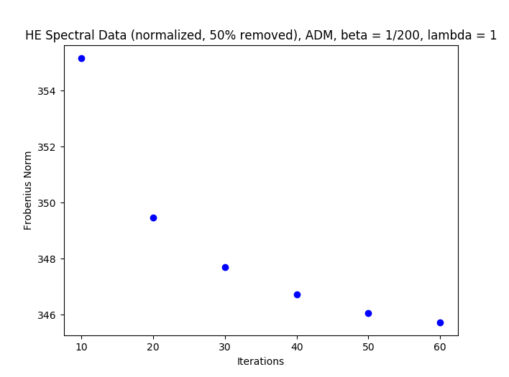
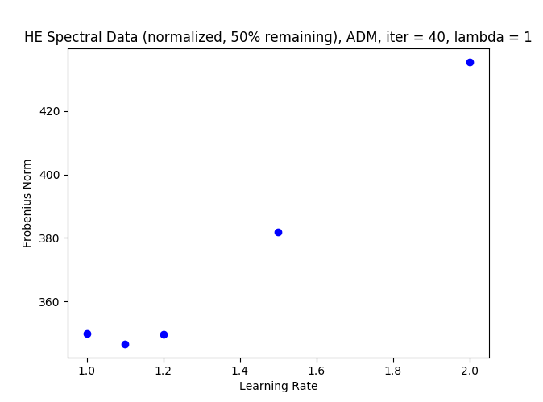
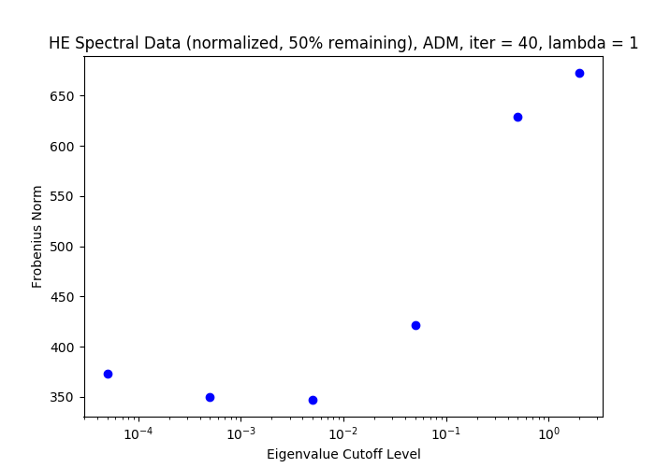
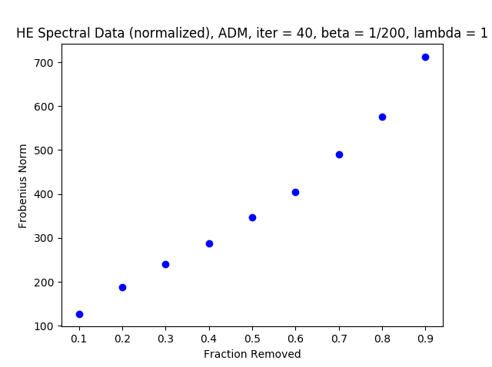
Hyperparameter Optimization: ADM
Plots show effects of various parameter settings for ADM algorithm
High Energy (HE) normalized (energy normalization) data set
Plots are Frobenius norm vs:
Iterations (top left)
Learning Rate (bottom left)
Eigenvalue cutoff level (top right)
Fraction removed (bottom right)
Compared to SiLRTC algorithm, ADM produces lower Frobenius scores and smaller Frobenius norm increases with non-optimal hyperparameters

Slide 11
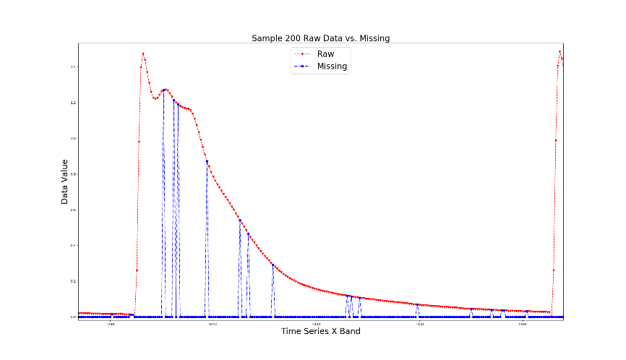
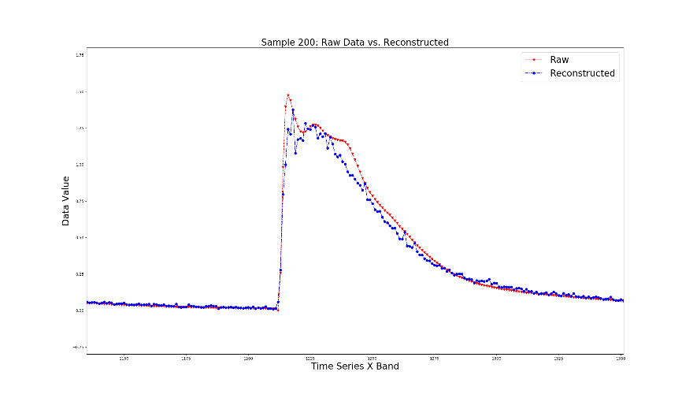
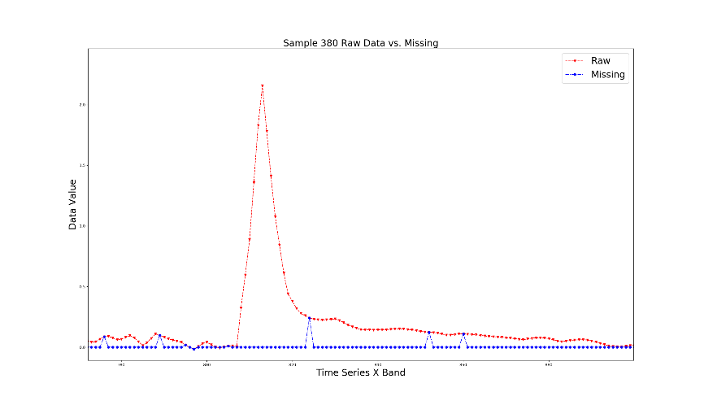
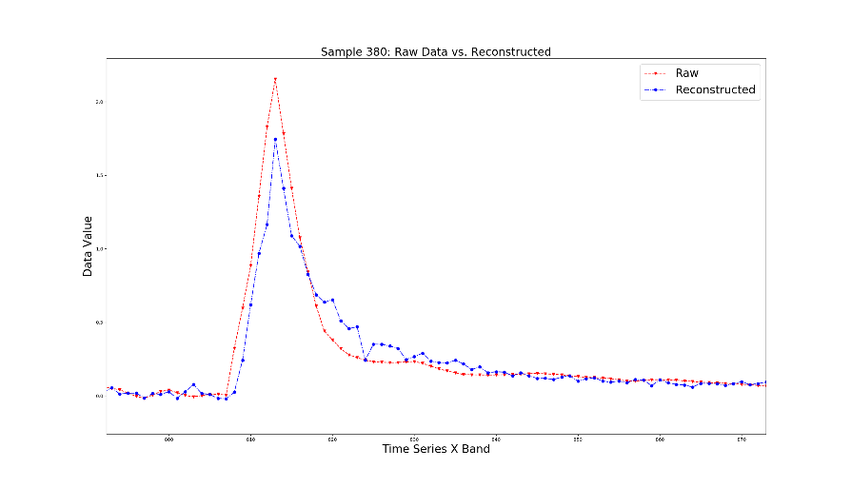
Salt and Pepper Noise: ADM Visual Comparison
Notes:
90% of original data missing
Data removed in “Salt-and-Pepper noise” fashion
Recovered data shows several fine features of original data

Slide 12
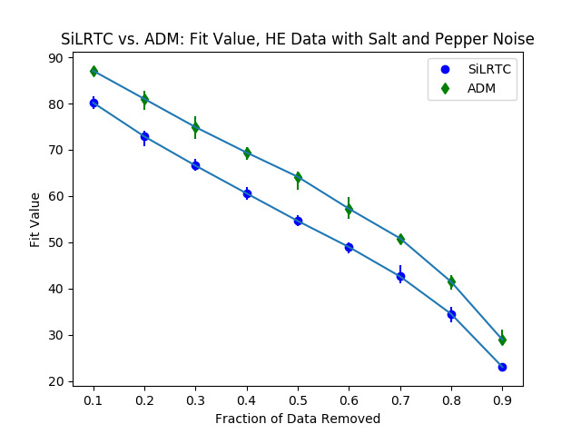
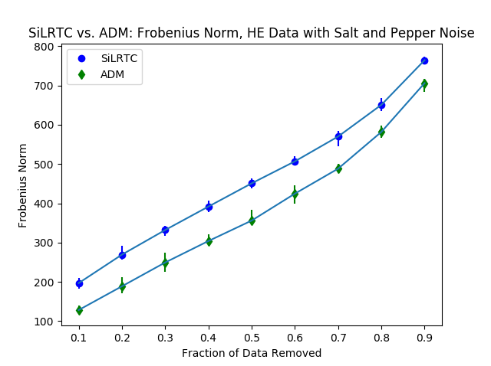
SiLRTC vs. ADM for Salt and Pepper Noise: Fit Metric
Notes:
Tested 10 trials for each fraction of data removed
Data point is mean fit value of 10 trials
Error bars are max/min fit value for each of the 10 trials
$Fit Value= \frac{1−fro(data, recovered)}{{\sum{X}}^{2}}$
$fro$ is Frobenius norm
data is original data
recovered is recovered data
$X$ is squared element-by-element
The sum of $X$over all elements

Slide 13
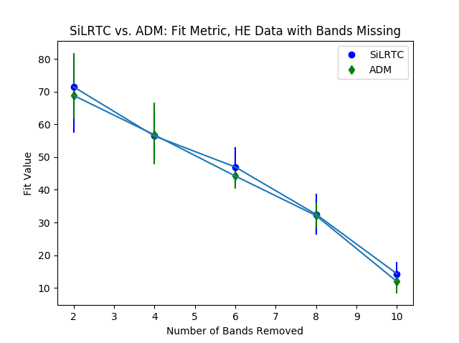
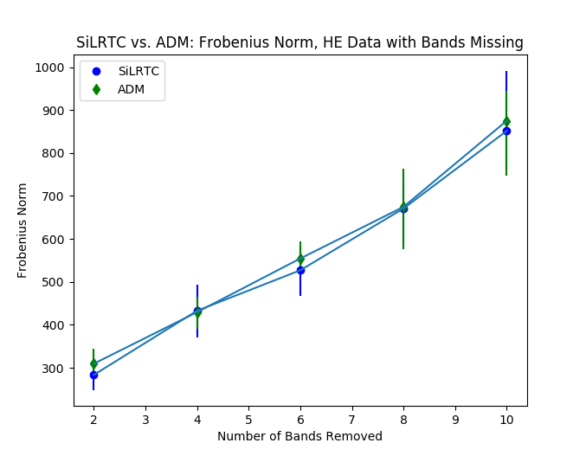
SiLRTC vs. ADM for Missing Bands: Fit Metric
Notes:
Tested 10 trials for each number of bands removed
Band removal follows rule that at least one band must be kept from first group of six and last group of six
Data point is mean fit value of 10 trials
Error bars are max/min fit value for each of the 10 trials
$Fit Value= \frac{1−fro(data, recovered)}{{\sum{X}}^{2}}$
$fro$ is Frobenius norm
data is original data
recovered is recovered data
$X$ is squared element-by-element
The sum of $X$over all elements

Slide 14
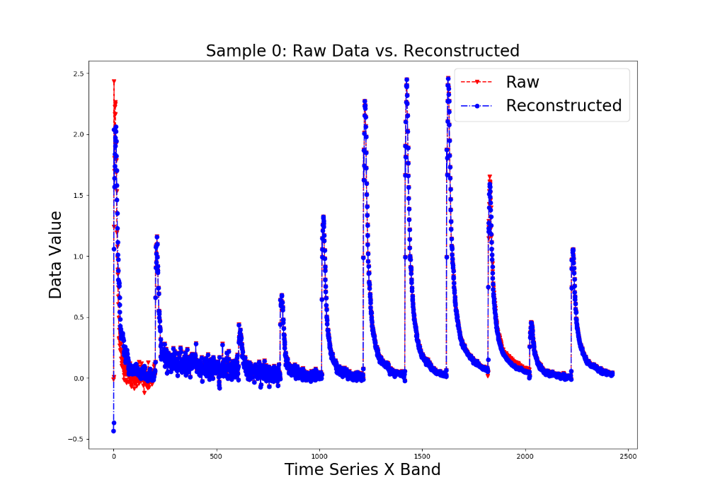
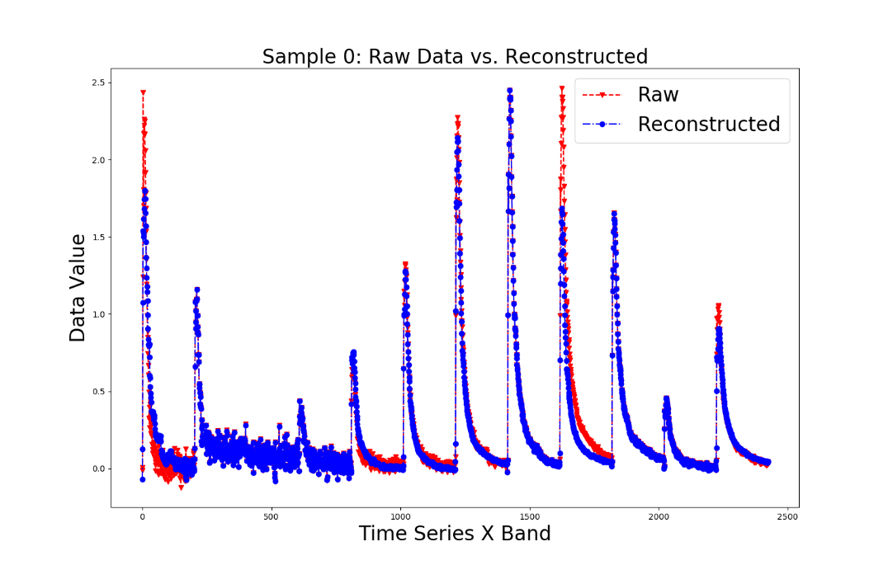
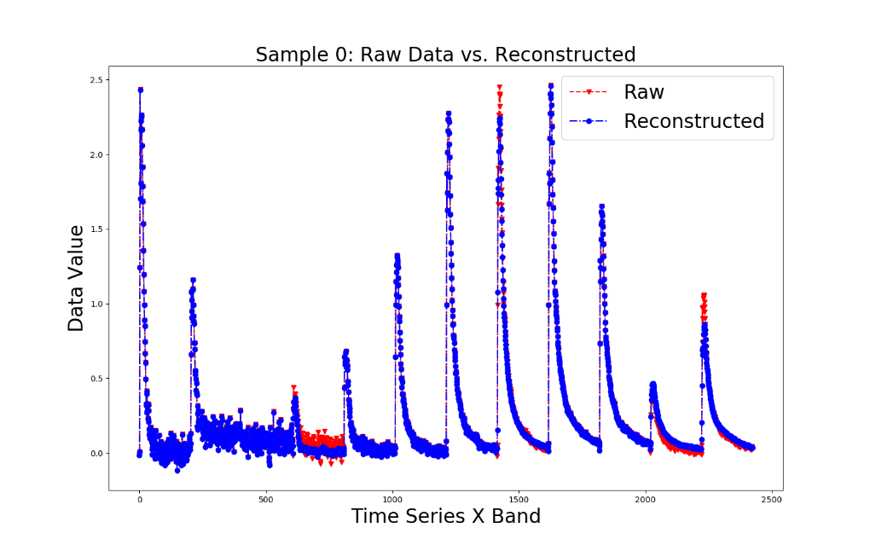
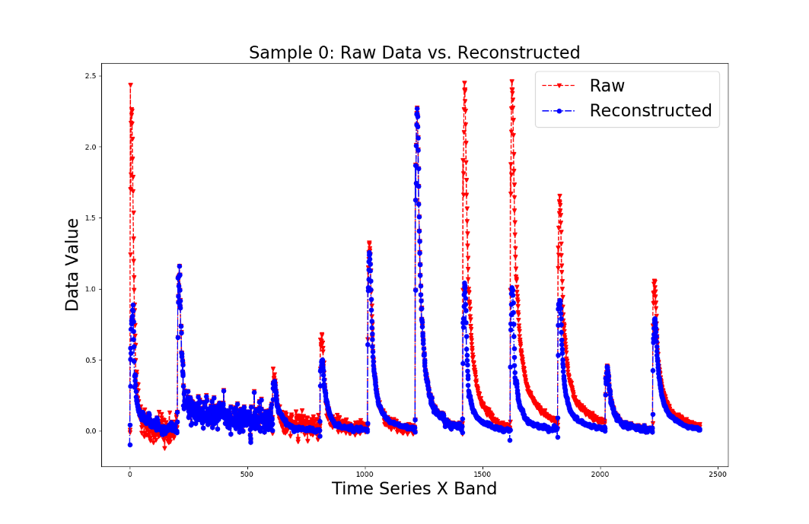
ADM Bands Missing
HE Data sets with bands missing
Completed with ADM algorithm
2 bands missing (top left), 4 bands missing (bottom left), 6 bands missing (top right), 8 bands missing (bottom right)

Slide 15
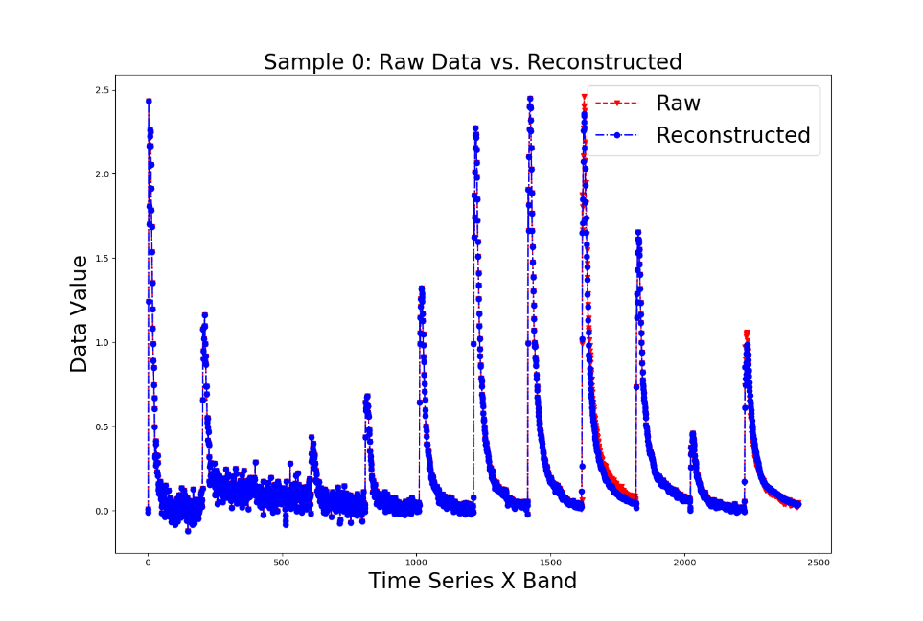
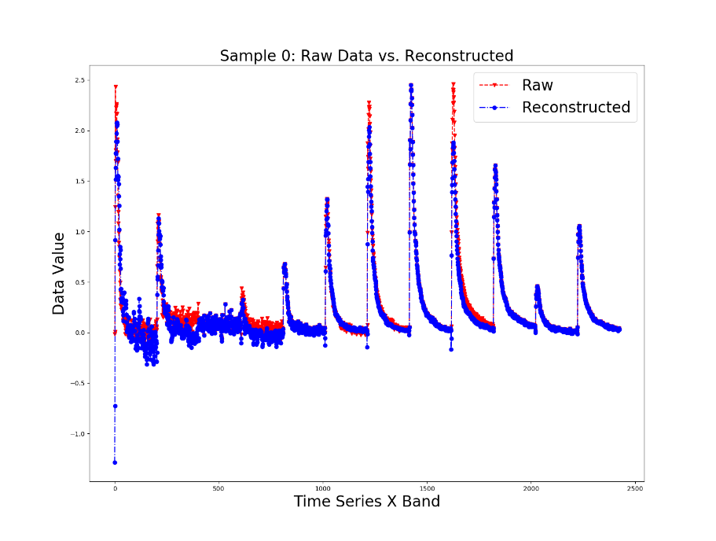
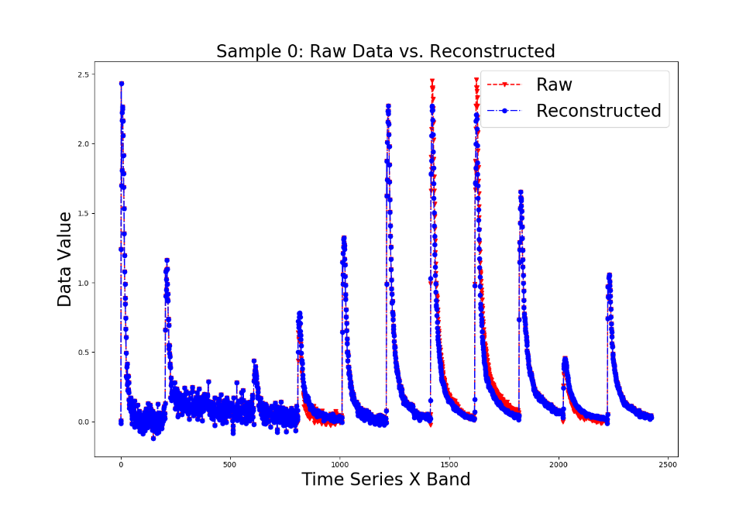
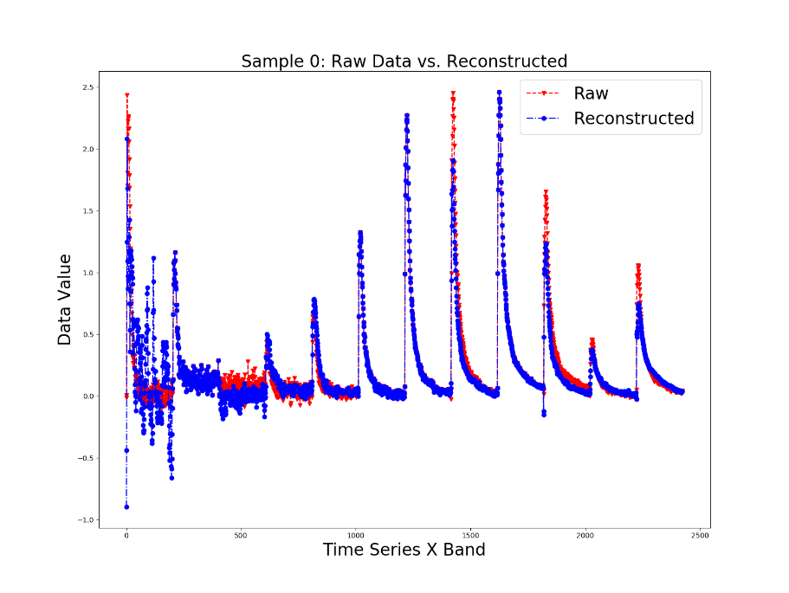
SiLRTC Bands Missing
HE Data sets with bands missing
Completed with SiLRTC algorithm
2 bands missing (top left), 4 bands missing (bottom left), 6 bands missing (top right), 8 bands missing (bottom right)

Slide 16
Conclusions
SiLRTC and ADM algorithm can recover visually close approximations of data sets with missing entries
Salt and Pepper Noise with 90% of data missing
ADM is better than SiLRTC for recovering data with salt and pepper noise present
Shown statistically through a large number of data sets with various amounts of missing data
ADM and SiLRTC equally good for data with bands missing
Possible that hyperparameters need to be reoptimized for missing bands case
What is the one-sentence summary of your R&D that you would want a technical person to remember?
Our team has written in Python and tested two algorithms that use nuclear norm minimization to iteratively solve tensor completion problems.
What is the one-sentence summary of your R&D that you would want a manager or program developer to remember?
If you have spectral or sensor data with missing values or you are interested in tensors method and the kinds of problems they can solve, please come talk to me.

Slide 17
Additional Slides

Slide 18
Abstract
The process of inferring missing data values in a multidimensional data array (data tensor) by using the information from known data values has several applications to Sandia’s mission areas. This presentation will detail our team’s efforts to research and test algorithms to solve the missing data inference problem. We will detail results from applying two algorithms – Simple Low Rank Tensor Completion (SiLRTC) and Alternating Decent Method (ADM) – to a Sandia spectrotemporal high energy (HE) multidimensional data set with data removed for testing purposes. Both algorithms work by using iterative methods that leverage nuclear norm minimization, with ADM also incorporating slack variables and gradient decent.
We will present results that show we can infer missing data values with high fidelity from a start with up to 90% of the original data missing. The results will further show that the more sophisticated ADM algorithm produces better statistical fits to the original data across a range of starting parameters and percent of original data removed.

Slide 19
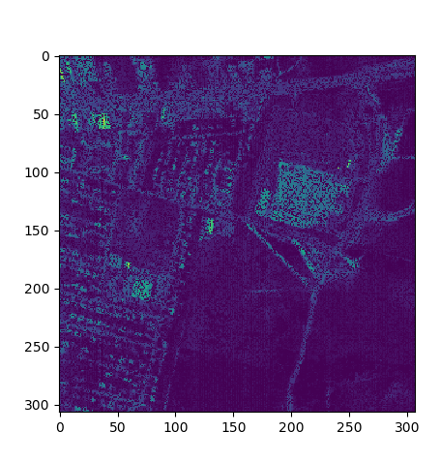
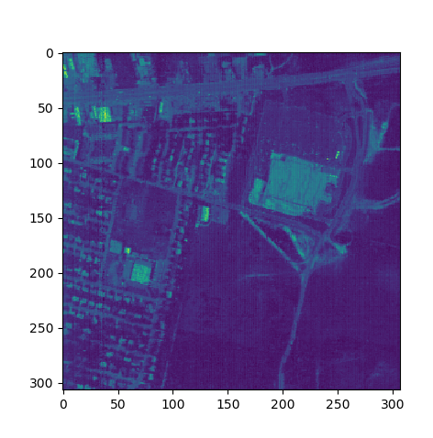
Matrix Hyperspectral Image Recovery
Notes:
Images from Army “Hypercube: URBAN” data set
Image: 400nm, ~300x300 pixels, uint16
Corrupted Image has 50% of pixels removed
Recovered image has had ~97% of pixels values restored to within +/- 5 counts of the original
Corrupted Image
Recovered Image

Slide 20
Conclusions
What is the one-sentence summary of your R&D that you would want a technical person to remember?
Our team has written in Python and tested two algorithms that use nuclear norm minimization to iteratively solve tensor completion problems.
What is the one-sentence summary of your R&D that you would want a manager or program developer to remember?
If you have spectral or sensor data with missing values or you are interested in tensors method and the kinds of problems they can solve, please come talk to me.
Do you prefer an oral or a poster presentation?
I prefer an oral presentation.
If oral, indicate presentation time between 15 and 30 minutes or a 5-minute spotlight.
I prefer a presentation time between 15 and 30 minutes.

